Slide 1
IoTP
Gareth, Nixon, Kirsty, Leonard

Slide 2
Proposed Project Idea
Proposed Solution
Custodians empty trash collection points to allow further trash collection.
The open-ended nature of the process leads to multiple issues:
Singapore has high levels of e waste produced
Unnecessary emptying of bins that are not yet full.
Other inefficiencies reducing process effectiveness.
Results in dissatisfied patrons and custodians, and a less clean environment.

Slide 3
Proposed Project Idea
Implement an IoT-assisted product to streamline waste collection and disposal.
Provide real-time information to help custodians make effective decisions.
Features include:
An admin dashboard for tracking individual employee and hardware performance and statistics.
RFID cards for custodians to tap at trash collection points for accurate tracking.
Data analysis tools (e.g., graphs) for visualizing statistics for users and admins.
Asynchronous data updates ensuring the latest information is always available.
A live status feature to alert admins if any sensor goes offline.

Slide 4
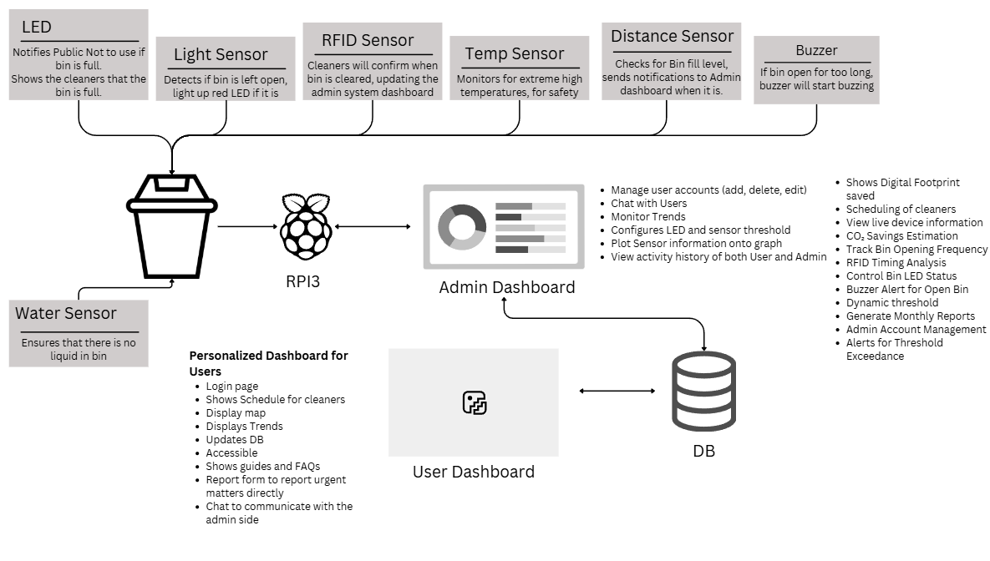
System Overview Diagram

Slide 5
Task Allocation (Gareth)
Designed databases
Login form/Logout
Forgot password
Password hashing & salting
Email notification
TOTP verification
Session management
Design admin dashboard layout
Account management (CRUD)
Bin management (CRUD)
Dynamic live charts
Live bin status summary
Logging
Hardware data sanitization
Analytical chart for light sensor insights - Bin usage peak hours

Slide 6
Task Allocation (Nixon)
Hardware:
Access RFID Reader (UART)
Buzzer
Light Sensor
Red and Green LED
Water sensor
Temperature sensor
Distance sensor
DataComms
Admin:
Chat/Messaging
Scheduling Cleaners when threshold is exceeded/Routine checks
DataComms
View Schedule Page
View Reports with images, resolve reports.
Designed and implemented hardware and threshold database.
Threshold Set dynamically
Device log page
  Tracks what time users are doing their duty for more effective planning
  Tracks trends and amount of Carbon footprint saved
  Export Device log data for further analysis

Slide 7
Task Allocation (Kirsty)
User side Application:
Statistics page: Daily statistics
Statistics page: Priority
Chat/Messaging
User Accessibility: Multi-language
Report
Shows guides and FAQs
Hamburger navigation menu
E-waste collected form
Schedule

Slide 8
Task Allocation (Leonard)
User side Application:
Login page and functionality
Statistics page: Data and simple visualizations
Statistics page: Graphs
Statistics page: Requirements
User controls
Alerts for user
Interactable graph
Log on users side

